Slide 1
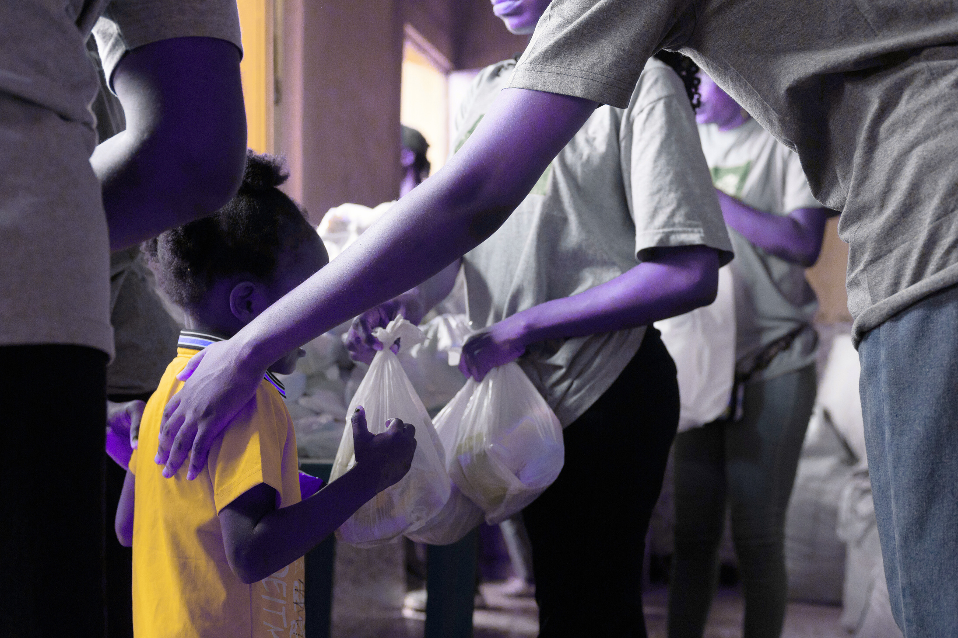
FOOD SURPLUS DISTRIBUTION PLATFORM
Connecting surplus food providers with NGOs and shelters in real time
Aditya Honnakasturi 2SD23IS006
Pratham Hegde 2SD23IS034
Kiran Jantgal 2SD24IS402
Pradyumna Naik 2SD23IS032

Slide 2
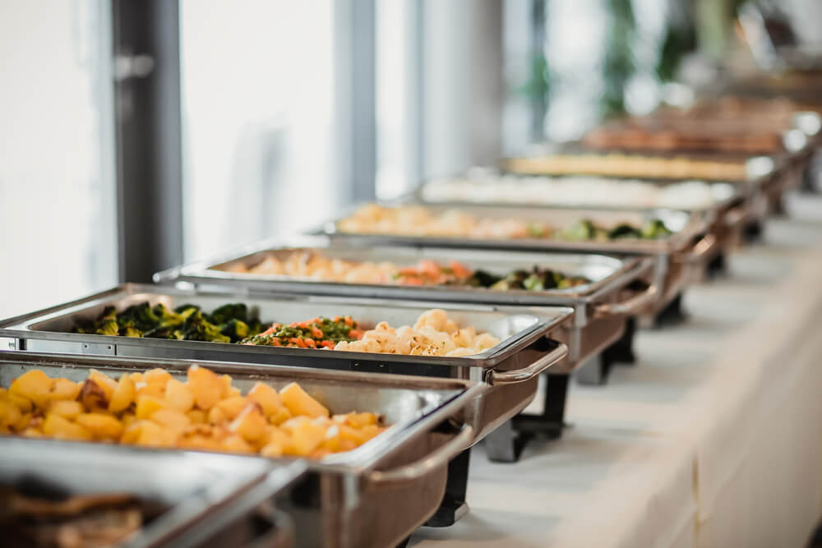
THE PROBLEM
  Large quantities of food are wasted in weddings, college fests, and functions due to uncertain turnout
  NGOs and shelters often lack food on the same day
  No structured platform to connect event organizers with NGOs in real-time

Slide 3

Why Focus on Events?
Events generate the highest surplus food in short time
Food is prepared in bulk, making distribution easier
Events happen regularly in colleges, weddings, functions
Strong opportunity to reduce wastage quickly

Slide 4
OUR SOLUTION
Provider
A Food Surplus Distribution Platform (Web + Mobile App) to:
  Enable providers to post surplus food details instantly
  Notify NGOs nearby in real-time
  Facilitate quick claim, pickup, and distribution
  Track and analyze food saved and shared
Platform
NGO
People in need

Slide 5
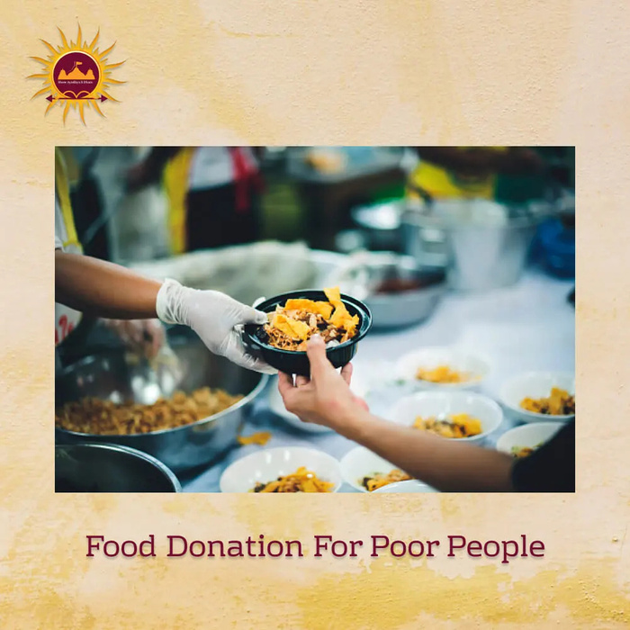
Why NGOs Need Our Solution?
“40% of food from large events goes to waste, while NGOs struggle daily to feed millions.”
  Over 7.5 crore people fed by NGOs every year in India
  Shelter homes & orphanages rely heavily on NGO support
  Even 10 wasted meals → 7 could feed the needy

Slide 6
CURRENT
PROPOSED
  Surplus food often discarded
  NGOs depend on calls/WhatsApp
  No records or analytics
  Delays in food collection due to lack of coordination
  Limited reach; some needy people or shelters miss out
  Providers post food details instantly
  NGOs receive real-time alerts
  Pickup and distribution confirmed in app
  Instant coordination reduces delays in food collection
  Data-driven reports on food saved

Slide 7





TECH STACK
  Backend: + Express.js
  Database: MongoDB Atlas
  Real-Time Notifications: Socket.io
  Authentication: JWT
  Frontend (Web): + TailwindCSS
  Mobile App: + FCM

Slide 8
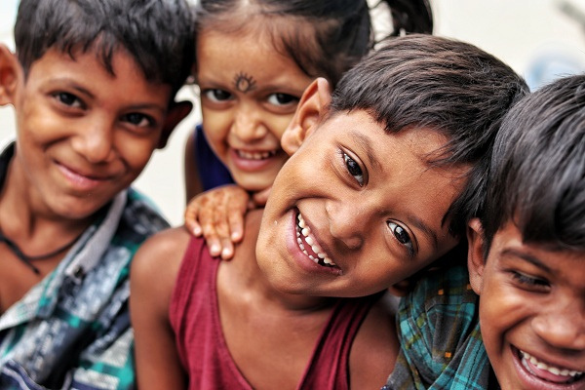
IMPACT
Food Providers
  Reduce waste by sharing surplus food
  Contribute to social responsibility
NGOs & Shelters
  Easy, reliable access to daily food needs
Community
  Reduce hunger: Surplus food reaches those in need, directly lowering food insecurity.
  Strengthen social ties: Encourages collaboration between providers, NGOs.
  Promote sustainability: Minimizes food waste.

Slide 9
CONCLUSION
Reduced wastage: Ensures surplus food safely reaches those in need instead of being discarded..
Increased social impact: Empowers providers and NGOs to make a meaningful difference in the community.
Sustainable community development: Supports long-term ethical practices and strengthens community welfare.
Environmental impact: Minimizes food waste, promoting sustainability and eco-friendly practices.

Slide 10
THANK YOU

